Slide 1
Logistic Regression
Y.LAKHMI PRASAD
08978784848

Slide 2
Objectives
Introduction to Logistic regression
Some Potential Problems and Solutions
Probability and Odds
Assumptions of Logistic Regression
Interpreting Coefficients in Logistic Regression
Evaluating the performance of the model

Slide 3
Binary Classification
The most common use of logistic regression models is in binary classification problems.
Bank customers seek loans from the bank promising to repay the loan in installments over a determined period of time and with some interest on the amount.
However, banks are always at a risk because many customers might not be able to pay their loans back.
This can cause big losses to the bank.

Slide 4
Classification Problem
Therefore, predicting credit risk is of utmost importance for the bank where the bank analyzes customers’ information and credit history before deciding to grant a loan.
Logistic Regression can be used to build a predictive modeling to predict how likely a customer is to default the repayment of the loan.

Slide 5
What is Classification?
PARTITIONING the (FEATURE) SPACE into PURE REGIONS assigned to each CLASS

Slide 6
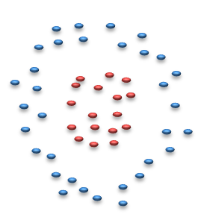
Two types of Classifiers
Descriptive (Generative) Classifiers
Learn class DENSITY Functions
Bayesian Classifiers
Nearest Neighbor
Discriminative Classifiers
Learn class SEPARATORS
Logistic Regression
Decision Trees
Neural Networks, SVM

Slide 7
Approaches to learn classifiers
1. Logistic Regression
2. K-Nearest Neighbour classifiers
3. Decision Trees
4. Bayesian Classifiers(NaiveBayes)
5. Support Vector Machines
6. Neural Networks
7. Bagging (Random Forest)
8. Boosting (Ada Boost, XG Boost)

Slide 8
Expectations from Model
Predictive (Classification ) accuracy: The ability of the model to correctly predict the class label of new or previously unseen data.
1. Accuracy = Percent (%) of testing set examples correctly classified by the classifier.
2. Speed: The computation costs involved in generating and using the model should be as minimum as possible.
3. Versatile: Ability of the model to make correct predictions given noisy data or data with missing values.
4. Scalability: Ability to construct the model efficiently given large amount of data.

Slide 9
Expectations from Model
5. Interpretability/ Explain-ability: Level of understanding and insight that is provided by the model
6. Generalized: It should be able to give the same amount of accuracy on validation set.
7. Deterministic: I expect my model to give me the same result every time I run it.
8. Regularization: I expect my model complexity should be controlled by me, So that I can prevent my model from over-fitting.

Slide 10
Logistic Regression
Logistic Regression is a supervised classification model.
It allows you to make predictions from labelled data, if the target (output) variable is categorical.
1. A bank wants to predict, based on some variables, whether a particular customer will default on a loan or not
2. A factory manager wants to predict, based on some variables, whether a particular machine will
break down in the next month or not
3. Google’s backend wants to predict, based on some variables, whether an incoming email is spam or not

Slide 11
Logistic Regression examples
Marketing: Classify whether the Lead is a Hot Lead or a warm lead.
Stock Market: predict whether the stock will outperform or under perform
Healthcare: Whether the tumour is malignant or benign
Networking: classify whether the packet is malicious or not.
Human Resource: whether the employee is going to leave the company(attrition) or not

Slide 12
Logistic Regression
Used because having a categorical outcome variable violates the assumption of linearity in normal regression.
Instead of building a predictive model for "Y (Response)" directly, the approach models “Log Odds (Y)”; hence the name Logistic or Logit.

Slide 13
Where is the Problem?
Dependent variable is limited to the [0 or 1] because we have 2 classes: default or no-default, Diabetic or Non diabetic, Churned or not churned etc.,.
Linear Regression is designed to solve the problem of Minimizing the Root Mean Squared Error, which does not seem to be an appropriate fit in this case.

Slide 14
Logistic Regression
Let us take the diabetes example, in this example, we try to predict whether a person has diabetes or not, based on that person’s blood sugar level.
Why a simple boundary decision approach does not work very well for this example.
It would be too risky to decide the class blatantly on the basis of cut-off, as especially in the middle, the patients could basically belong to any class, diabetic or non-diabetic.

Slide 15
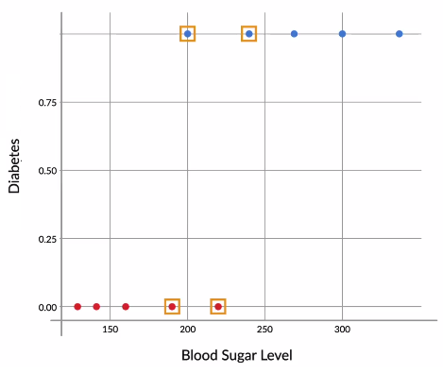
Classifying with Linear Regression

Slide 16
Where is the Problem?
recall the graph of the diabetes example.
Suppose there is another person, with a blood sugar level of 195, and you do not know whether that person has diabetes or not. What would you do then? Would you classify him/her as a diabetic or as a non-diabetic?

Slide 17
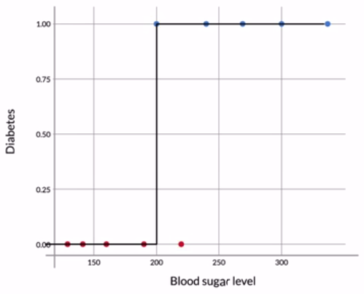
Step Function

Slide 18
Limitation of Step Function
Now, based on the boundary, you may be tempted to declare this person a diabetic, but can you really do that?
This person’s sugar level (195 mg/dL) is very close to the threshold (200 mg/dL), below which people are declared as non-diabetic.
It is, therefore, quite possible that this person was just a non-diabetic with a slightly high blood sugar level.
After all, the data does have people with slightly high sugar levels (220 mg/dL), who are not diabetics.

Slide 19
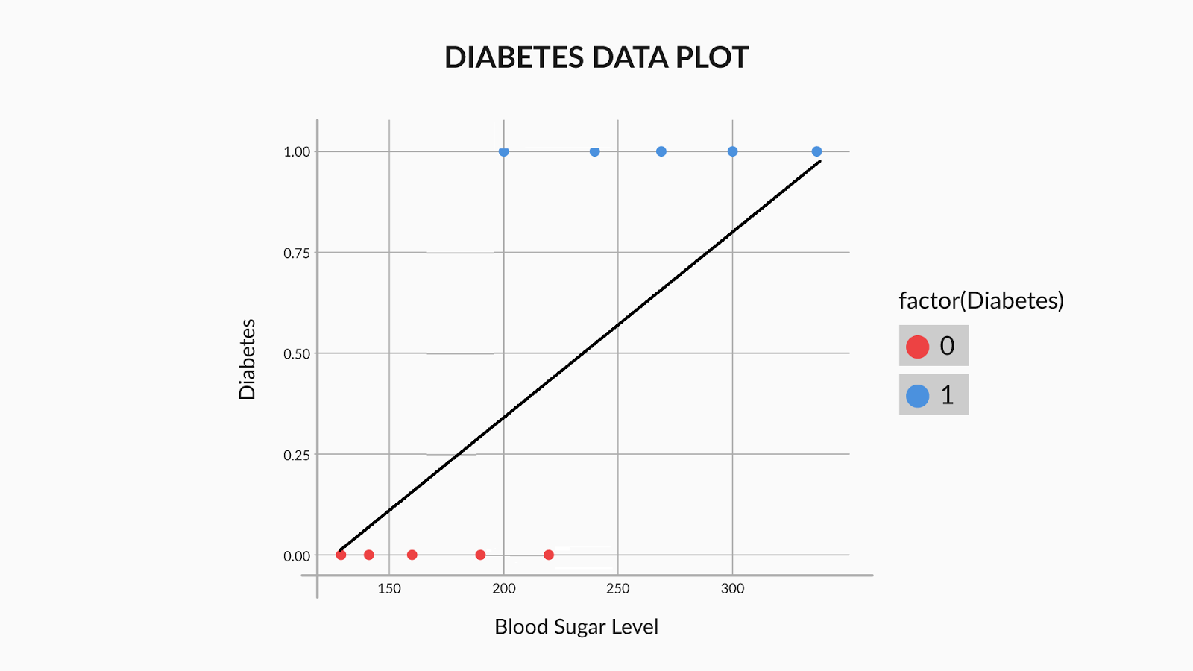
Classifying with Linear Regression

Slide 20
Classifying with Linear Regression
The main problem with a straight line is that it is not steep enough.
In the sigmoid curve, as you can see, you have low values for a lot of points, then the values rise all of a sudden, after which you have a lot of high values.
In a straight line though, the values rise from low to high very uniformly, and hence, the “boundary” region, the one where the probabilities transition from high to low is not present.

Slide 21
Logistic Regression
In this situation, We actually like to talk in terms of probability.
One such curve which can model the probability of diabetes very well, is the sigmoid curve.

Slide 22
sigmoid curve
sigmoid curve has all the properties you would want — extremely low values in the start, extremely high values in the end, and intermediate values in the middle — it’s a good choice for modelling the value of the probability of diabetes.

Slide 23
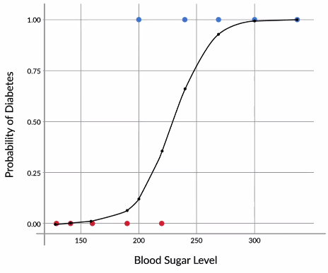
S-Curve

Slide 24
Here, We want to have the P1,P2,P3,P4,P6 to be as small as possible and P5,P7,P8,P9,P10 to be as high as possible.
In case of P4, I can say either I want to minimize P4 or I can even say I want to maximize 1-P4.
Comprehensively, If I want to maximize all these points into the same assumption, I can say I want to maximize P5,P7,P8,P9,P10 and 1-P1,1-P2,1-P3,1-P4,1-P6.
That means I want to maximize the product of all these points. So, we want to find out that B0 and B1 which maximizes the product of all these points.

Slide 25
Best-fit Curve
The next step, just like linear regression, would be to find the best fit curve.
Hence, you learnt that in order to find the best fit sigmoid curve, you need to vary β0 and β1 until you get the combination of beta values that maximises the likelihood.

Slide 26
Understanding Likelihood
Now, let’s say that for the ten points in our example, the labels are as follows:
In this case, the likelihood would be equal to:
A) (1−P1)(1−P2)(1−P3)(1−P4)(1−P5)(P6)(P7)(P8)(P9)
B) (1−P1)(1−P2)(1−P3)(1−P5)(P4)(P6)(P7)(P8)(P9)
C) (P1)(P2)(P3)(P4)(P5)(1−P6)(1−P7)(1−P8)(1−P9)
D) (P1)(P2)(P3)(P5)(1−P4)(1−P6)(1−P7)(1−P8)(1−P9)
Point no. | 1 | 2 | 3 | 4 | 5 | 6 | 7 | 8 | 9
Diabetes | no | no | no | yes | no | yes | yes | yes | yes

Slide 27
Feedback :Recall that likelihood is the product of (1−Pi) for all non-diabetic patients and (Pi) for all diabetic patients. Hence, the likelihood is given by (1−P1)(1−P2)(1−P3)(1−P5), (all non-diabetic patients) multiplied by (P4)(P6)(P7)(P8)(P9)(P10) (all diabetic patients).

Slide 28
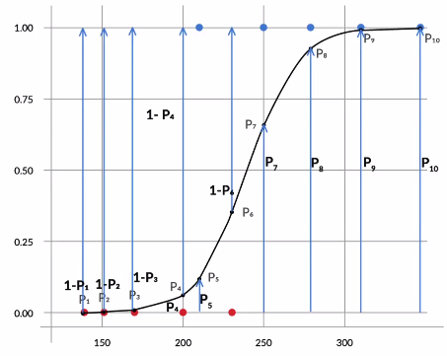
Logistic Regression Best fit curve

Slide 29
Logistic Regression Best fit curve
If you had to find β0 and β1 for the best fitting sigmoid curve, you would have to try a lot of combinations, unless you arrive at the one which maximises the likelihood.
This is similar to linear regression, where you vary β0 and β1 until you find the combination that minimises the cost function.
Hence, this is called a Generalised Linear regression Model (GLM), or a logistic regression model.

Slide 30
ODDS
The odds has a range of 0 to ∞ with values greater than 1 associated with an event being more likely to occur than to not occur and values less than 1 associated with an event that is less likely to occur than not occur

Slide 31
Log(Odds)
It solves the problem we encounter in fitting a linear model to probabilities.
As probabilities (the dependent variable) only range from 0 to 1, we can get linear predictions that are outside of this range

Slide 32
What is an "Odds Ratio”?
It is a standard statistical term that denotes probability of success to probability of failure.
If probability of success is 0.75, then odds ratio = (0.75/0.25) = 3
In other words, there is a 3:1 chance of success
If probability of success is 50%, what is the odds ratio?

Slide 33
Why Use Odds-Ratio
In logistic regression the Odds Ratio represents the constant effect of a predictor X, on the likelihood that one outcome will occur.
In regression models, we often want a measure of the unique effect of each X on Y.
If we try to express the effect of X on the likelihood of a categorical Y having a specific value through Probability, the effect is not constant.

Slide 34
Why Use Odds-Ratio
That means there is no way to express in one number how X affects Y in terms of Probability.
The effect of X on the probability of Y has different values depending on the value of X.
We will not be able to describe that effect in a single number using Probability and will have to use Odds Ratio

Slide 35
The Logistic Regression Model
The "logit" model: ln[p/(1-p)] = β₀ + β₁X
p is the probability that the event Y occurs, p(Y=1)
[range=0 to 1]
p/(1-p) is the "odds ratio"
[range=0 to ∞]
ln[p/(1-p)]: log odds ratio, or "logit“
[range=-∞ to +∞]

Slide 36
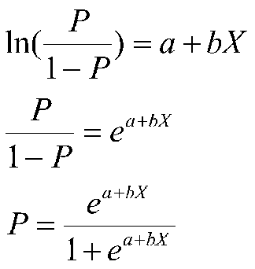
Logistic regression Model

Slide 37
Types of Logistic Regression
1. Binary Logit: Used when the response variable is binary or dichotomous. It has only 2 outcomes e.g. Good v/s Bad,
Yes v/s No
2. Multinomial Logit: Used when the response variable has more than 2 outcomes, and The outcomes cannot be ordered in any manner e.g. Choice of bread.
3. Ordered Logit: Used when the response variable has more than 2 outcomes, and The outcomes can be ordered in a meaningful way.
High / Medium / Low,
Strongly Agree / Agree / Disagree / Strongly Disagree

Slide 38
Response Variable coding
Data Preparation for Logistic Regression includes:
The response variable (or target variable) will need to be converted to a 1,0
Code "Sanctioned personal loan" as "1" and "Rejected personal loan" as "0"

Slide 39
Considerations
1. Missing value treatment - using logical rules
2. Outlier detection - to ensure we don't have highly skewed values
3. Multicollinearity- two independent variables do not provide similar information
4. Variable transformations- we have meaningful transformation of variables depending on the research and modeling scope
5. Descriptive statistics - Basic measures of central tendency need to be output to validate if correct data is being used for modeling

Slide 40
Assumptions
Makes fewer assumptions than Linear Regression
Non-linear transformation of the logistic function
No assumption on normal distribution for residuals.
No Homoscedastic assumption.

Slide 41
Data Preparation Partitioning
Divide the sample into 2 sub-samples
1. Training Sample: Sample used to build Logistic regression model.
2. Validation Sample: Estimates obtained from the development sample will be tested here for comparison and checking robustness of the model

Slide 42
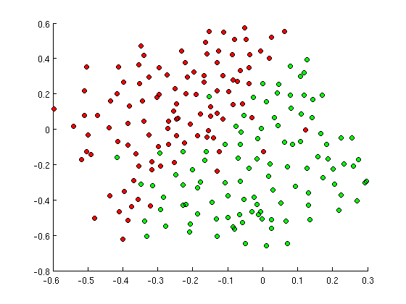
Simple Decision Boundary?

Slide 43
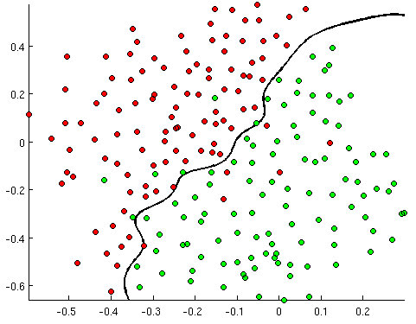
Medium Decision Boundary!

Slide 44
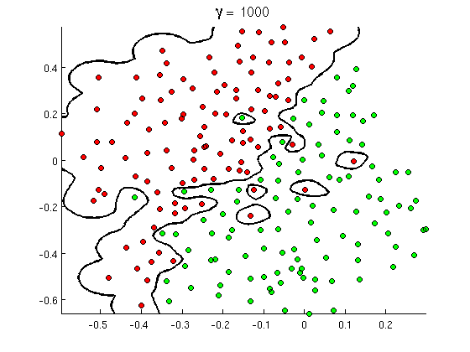
Complex Decision Boundary!

Slide 45
Model SIGNAL not NOISE
Model is too simple → UNDER LEARN
Model is too complex → MEMORIZE
Model is just right → GENERALIZE

Slide 46
Generalization vs. Memorization
Generalization: The ability to predict or assign a label to a “new” observation based on the “model” built from past experience

Slide 47
Generalize, don’t Memorize!
Training Set Accuracy
Right Level of Model Complexity
Model Accuracy
Validation Set Accuracy
Model Complexity

Slide 48
Questions for Classification!
What is the NATURE of classifier’s DECISION BOUNDARY?
What is the COMPLEXITY of classifier’s DECISION BOUNDARY?
How do I CONTROL the COMPLEXITY of the classifier?
How do I know when the classifier is COMPLEX ENOUGH?
How to pick the right CLASSIFIER to use?

Slide 49
Metrics to Evaluate
1. Confusion Matrix (Accuracy, Sensitivity, Specificity )
2. Receiver Operating characteristic Curve
3. Weight of Evidence
4. Concordant, Discordant, Tied Pairs
5. Area Under Curve (c-Statistic)
6. Akaike Information Criterion
7. Gini Coefficient

Slide 50
Event Rate
Event rate is a statistical term that describes how often an event occurs.
Divide the number of times the occurrence happened by the total times the occurrence could happen to determine the event rate.

Slide 51
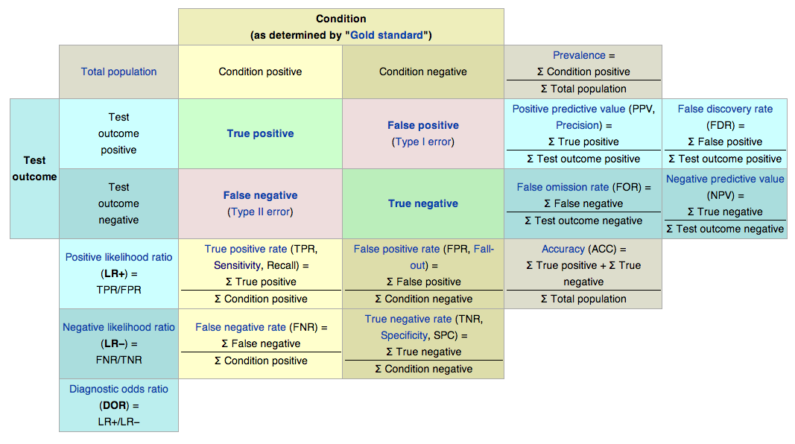
Confusion Matrix

Slide 52
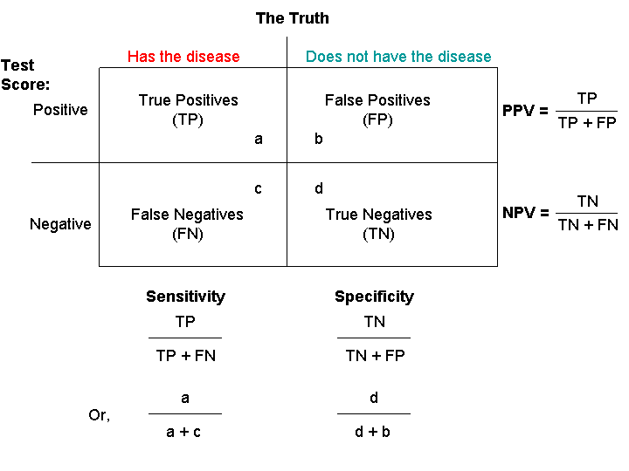
Sensitivity & Specificity

Slide 53
Receiver Operating Characteristic (ROC) Curve
Tradeoff between sensitivity and specificity
The closer the curve follows the left-hand border and then the top border of the ROC space, the more accurate the test.
The closer the curve comes to the 45-degree diagonal of the ROC space, the less accurate the test

Slide 54
Weight of Evidence (WoE)
The weight of evidence tells the predictive power of an independent variable in relation to the dependent variable.
The WoE recoding of predictors is particularly well suited for subsequent modeling using Logistic Regression.
For a continuous variable, split data into 10 parts (or lesser depending on the distribution).
Calculate WOE by taking natural log of division of % of non-events and % of events.

Slide 55
Information Value
Information value is a useful concept for variable selection during model building.
It helps to rank variables on the basis of their importance
Information Value -- Variable Predictive Power
< 0.02 -- Not useful
> 0.02 to 0.1 -- Weak predictive power
> 0.1 to 0.3 -- Medium predictive power
> 0.3 to 0.5 -- Strong predictive power
> 0.5 -- Suspicious predictive power

Slide 56
Concordant, Discordant
Concordant : Percentage of pairs where the observation with the event has a higher predicted probability than the observation without the event
Percent Concordant = (Number of concordant pairs)/Total number of pairs
Discordant : Percentage of pairs where the observation with the event has a lower predicted probability than the observation without the event
Percent Discordance = (Number of discordant pairs)/Total number of pairs

Slide 57
c-Statistic
Tied : Percentage of pairs where the observation with the event has same predicted probability than the observation without the event
Percent Tied = (Number of tied pairs)/Total number of pairs
c statistics : Also called area under curve (AUC). It is calculated by adding Concordance Percent and 0.5 times of Tied Percent
C- statistic = Percent Concordant + 0.5 * Percent Tied
Higher percentages of concordant pairs and lower percentages of discordant and tied pairs indicate a more desirable model.

Slide 58
Akaike Information Criterion (AIC)
The Akaike Information Criterion (AIC) provides a method for assessing the quality of model through comparison of related models.
It’s based on the Deviance, but penalizes for making the model more complicated.
Much like adjusted R-squared, it’s intent is to prevent from including irrelevant predictors.
If you have more than one similar candidate models then you should select the model that has the smallest AIC.

Slide 59
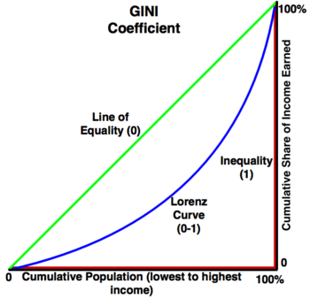
Gini Coefficient
Gini coefficient can be straight away derived from the AUC ROC number.
Gini is nothing but ratio between area between the ROC curve and the diagonal line & the area of the above triangle
Gini above 60% is a “good” model.

Slide 60
Imbalanced Datasets – SMOTE
Synthetic Minority Over-sampling Technique:
Imbalanced data sets are a special case for classification problem where the class distribution is not uniform among the classes.
These type of sets gives a challenge because this creates a bias towards the majority class.
Oversampling involves using a bias to select more samples from one class than from another.
The general idea of this method is to artificially generate new examples of the minority class using the nearest neighbors of these cases.
The majority class examples are also under-sampled, leading to a more balanced dataset

Slide 61
Questions?

